Slide 1



RRT Path Planning for Self
Driving Cars on a Highway
ENPM661 Project 5 - Spring 2020
Justin Albrecht, Brian Bock, Mahmoud Dahmani

Slide 2
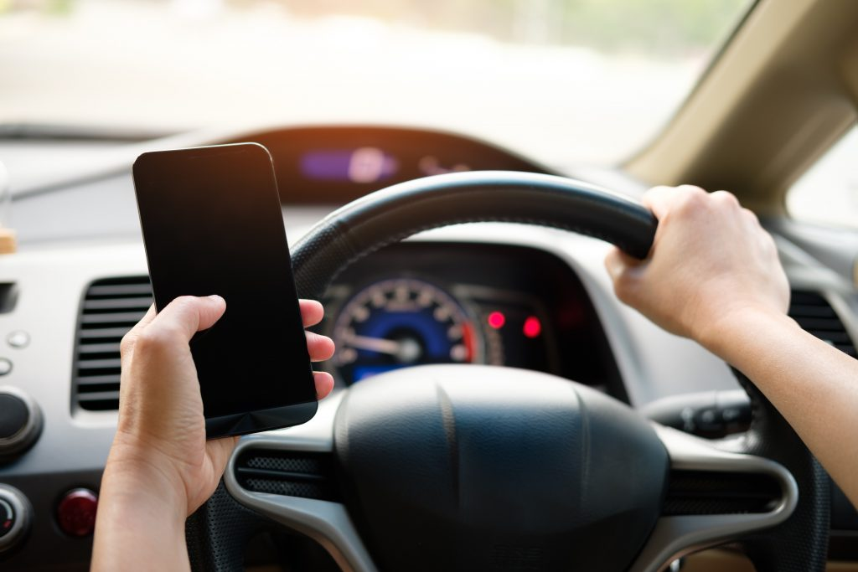
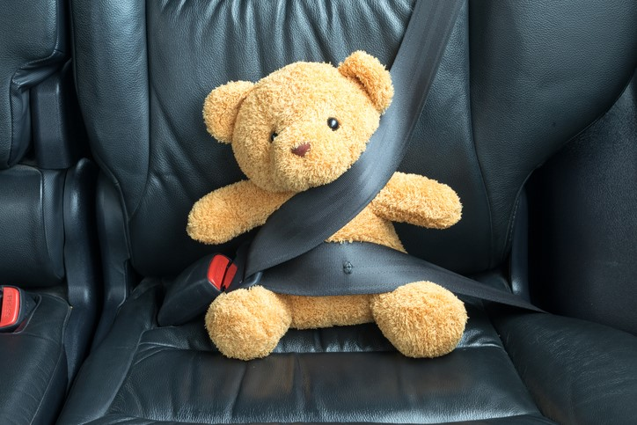
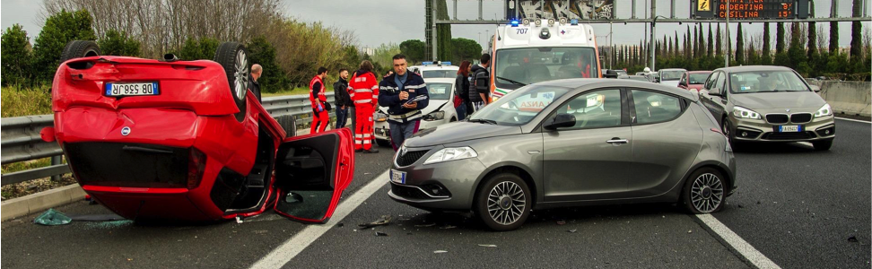
Introduction - Why Autonomous Cars?
In 2018, 36,560 people were killed in motor vehicle crashes.
9 out of 10 (94%) serious roadway crashes occur due to human behavior [1] [2] [3]
Humans get distracted, fatigued, angry, and even at our best, have limited FOV and attention
There is significant opportunity for improved safety by phasing out human drivers in favor of autonomously driven cars

Slide 3

Why simulation?
Testing new autonomous vehicle algorithms in the real world can be both expensive and dangerous, especially when human-occupied vehicles are nearby.
According to the Bureau of Transportation Statistics, in 2017, vehicles drove over 5.5 million miles on US highways
In simulation, any number of cars can be driven through greatly varied situations, offering companies a safe venue to test their algorithms and strategies and train their autonomous driving intelligences [6].
Through simulation, engineers can test, refine, and validate their systems, building confidence for ultimate real world tests.
Notes:
There is high risk for human injury and damage to expensive capital when testing in the real world, especially with unprovened systems.

Slide 4
Method
Build out a long road with other cars as obstacles
Use RRT to generate a graph navigating from the start to end of the road
Use vehicle motion constraints to define action set
Search graph to find optimal path to goal
Update the planner whenever our current plan is not valid (when newly sensed obstacles impact our plan)
Drive the car using the nonholonomic constraints from the start to the goal

Slide 5
Path Planner
RRT Algorithm
G.init(q_start)
q_sample = G.Random_Configuration(C)
q_near= Nearest(G, q_sample)
q_new = Stopping_State(q_near, q_sample, distance)
If there exists an obstacle-free motion from q_near to q_new then
graph.add(q_near, q_new)
Repeat steps 2 through 5 until q_goal is reached
Note: q_goal has a 5% sampling probability so that it won’t be sampled every iteration, otherwise the RRT fails and wastes much effort in running into C_obs instead of exploring the space.

Slide 6
Action Planner
The path planner is intended to be fast, and so it just outputs an obstacle-free path without having to worry about the differential constraints.
The action planner then takes the path waypoints as inputs and process them to produce an action sequence that satisfies the differential constraints of the car.
Breaking the trajectory planning problem into 2 stages like this enables us to simplify the design of each stage, and therefore we can achieve a very efficient implementation of a motion planner that is suitable for real-time highway driving

Slide 7
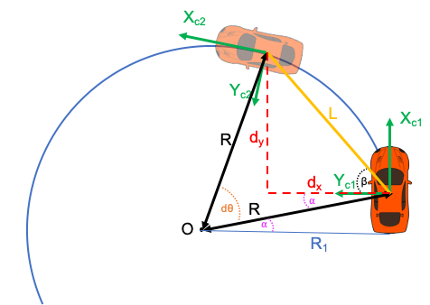
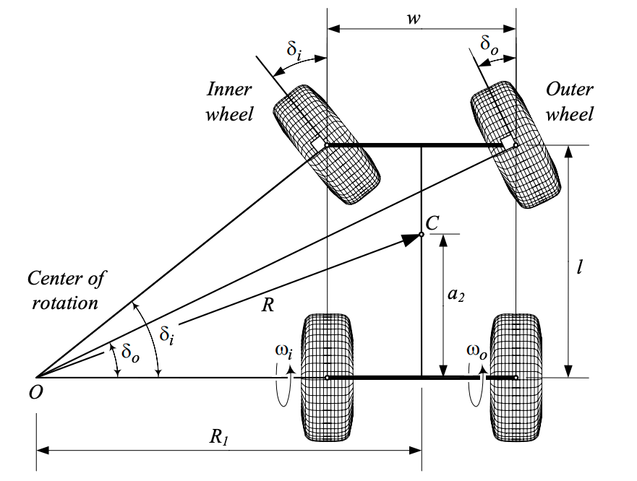
Car Motion
The car we are modeling is a front wheel steer (FWS), rear wheel drive (RWD), 4 wheeled vehicle utilizing Ackerman steering.

Slide 8

The Course
START

Slide 9
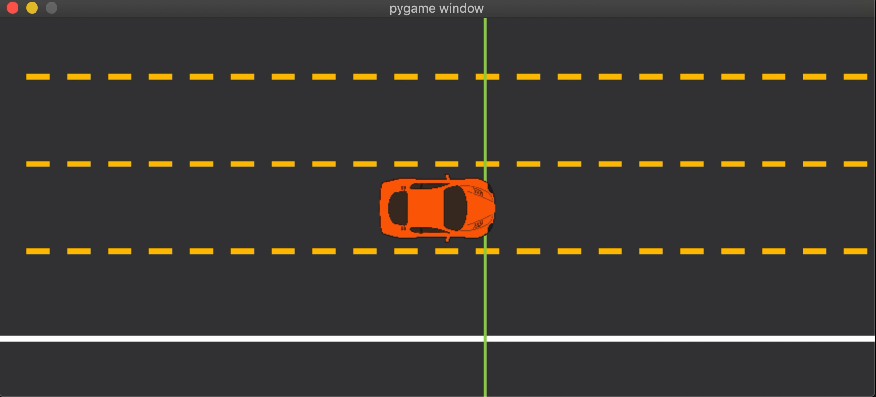
Final Video

Slide 10
References
[1] National Center for Statistics and Analysis, “2018 Fatal Motor Vehicle Crashes: Overview. (Traffic Safety Facts Research Note. Report No. DOT HS 812 826),” October 2019. [Online]. Available: https://crashstats.nhtsa.dot.gov/Api/Public/ViewPublication/812826
[2] NHTSA, “AUTOMATED DRIVING SYSTEMS 2.0 A Vision for Safety,” September 2017. [Online]. Available:
https://www.nhtsa.gov/sites/nhtsa.dot.gov/files/documents/13069a-ads2.0 090617 v9a tag.pdf
[3] Santok Singh, “Critical reasons for crashes investigated in the National Motor Vehicle Crash Causation Survey. (Traffic Safety Facts Crash Stats. Report No. DOT HS 812 115),” February 2015. [Online]. Available: https://crashstats.nhtsa.dot.gov/Api/Public/ViewPublication/812115
[4] SAE, “Taxonomy and Definitions for Terms Related to On-Road Motor Vehicle Automated Driving Systems J3016 201401,” January 2014. [Online]. Available: https://saemobilus.sae.org/download/?saetkn= 7Ab97uLiFw&method=downloadDocument&contentType=pdf&prodCode=J3016 201806&cid=1000408663
[5] Bureau of Transportation Statistics, “U.S. Passenger-Miles,” 2018. [Online]. Available: https://www.bts.gov/ content/us-passenger-miles
[6] A. Dosovitskiy, G. Ros, F. Codevilla, A. Lopez, and V. Koltun, “CARLA: An open urban driving simulator,” in Proceedings of the 1st Annual Conference on Robot Learning, 2017, pp. 1–16. [Online]. Available: http://proceedings.mlr.press/v78/dosovitskiy17a/dosovitskiy17a.pdf
[7] P. Robbel, M. Maass, R. D. T. M. Meijs, M. Harb, and et al., “Safety first for automated driving,” 2019. [Online]. Available: http://apollo.auto/docment/Safety First for Automated Driving handover to PR.pdf
[8] L. Han, Q. H. Do, and S. Mita, “Unified path planner for parking an autonomous vehicle based on rrt,” in 2011 IEEE International Conference on Robotics and Automation, 2011, pp. 5622–5627.
[9] Y. Wang, D. K. Jha, and Y. Akemi, “A two-stage rrt path planner for automated parking,” in 2017 13th IEEE Conference on Automation Science and Engineering (CASE), 2017, pp. 496–502. [Online]. Available: https://ieeexplore.ieee.org/document/8256153
[10] M. C ́ap, P. Nov ́ak, J. Vokˇr ́ınek, and M. Pˇechouˇcek, “Multi-agent rrt*: Sampling-based cooperative pathfinding
(extended abstract),” 2013.
[11] A. Sintov and A. Shapiro, “Time-based rrt algorithm for rendezvous planning of two dynamic systems,” in 2014
IEEE International Conference on Robotics and Automation (ICRA), 2014, pp. 6745–6750.
[12] D. Dolgov, S. Thrun, M. Montemerlo, and J. Diebel, “Path planning for autonomous vehicles in unknown semi-structured environments,” The International Journal of Robotics Research, vol. 29, no. 5, pp. 485–501, 2010. [Online]. Available: https://doi.org/10.1177/0278364909359210
[13] S. Klemm, J. Oberl ̈ander, A. Hermann, A. Roennau, T. Schamm, J. M. Zollner, and R. Dillmann, “Rrt*- connect: Faster, asymptotically optimal motion planning,” in 2015 IEEE International Conference on Robotics and Biomimetics (ROBIO), 2015, pp. 1670–1677.
[14] I. Noreen, A. Khan, and Z. Habib, “A Comparison of RRT, RRT* and RRT*-Smart Path Planning Algorithms,” IJCSNS International Journal of Computer Science and Network Security, vol. 16, no. 10, October 2016. [Online]. Available: http://222.124.154.59/politala/1.%20Jurusan/Teknik%20Informatika/19.%20e-journal/ Jurnal%20Internasional%20TI/IJCSNS/2016%20Vol.%2016%20No.%2010/20161004 A%20Compar%20ison% 20of%20RRT,%20RRT%20and%20RRT%20-%20Smart%20Path%20Planning%20Algorithms.pdf
[15] ——, “Optimal Path Planning using RRT* based Approaches: A Survey and Future Directions,” (IJACSA) International Journal of Advanced Computer Science and Applications, vol. 7, no. 11, 2016. [Online]. Available: https://pdfs.semanticscholar.org/9c35/2fec7a86c875eec17fc054106414b6914b7d.pdf
[16] S. M. LaValle, Planning Algorithms. Cambridge, U.K.: Cambridge University Press, 2006. [Online]. Available: http://planning.cs.uiuc.edu/

Slide 11
Images
https://www.findingtheuniverse.com/tips-for-driving-in-usa/
https://cochranfirmphiladelphia.com/wp-content/uploads/2018/06/Untitled-1.png
https://www.siegfriedandjensen.com/blog/understanding-reckless-driving/
https://texashillcountry.com/new-study-reminds-us-just-how-important-car-seat-safety-is/20374435_1220598001384173_8571822487193967772_n/
https://www.moddb.com/groups/indie-devs/tutorials/how-to-make-a-simple-grass-texture-in-gimp
http://ckw.phys.ncku.edu.tw/public/pub/Notes/GeneralPhysics/Powerpoint/Extra/05/11_0_0_Steering_Theroy.pdf
http://clipart-library.com/overhead-car-cliparts.html

